Slide 1
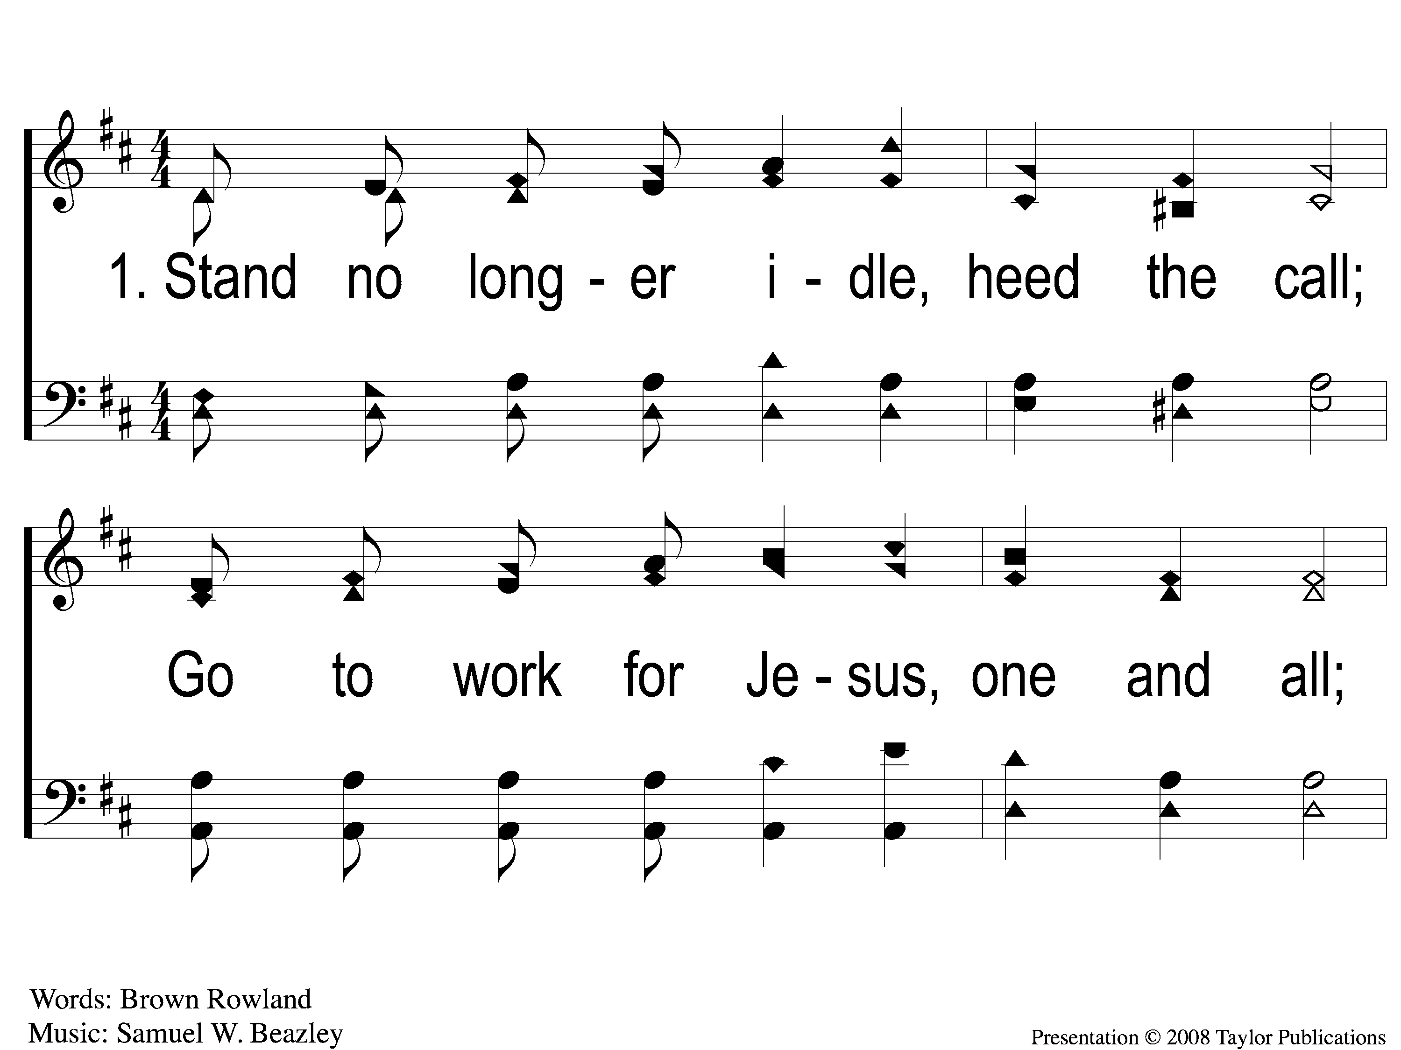
1-1 Go Into the Field
Go Into the Field
128

Slide 2
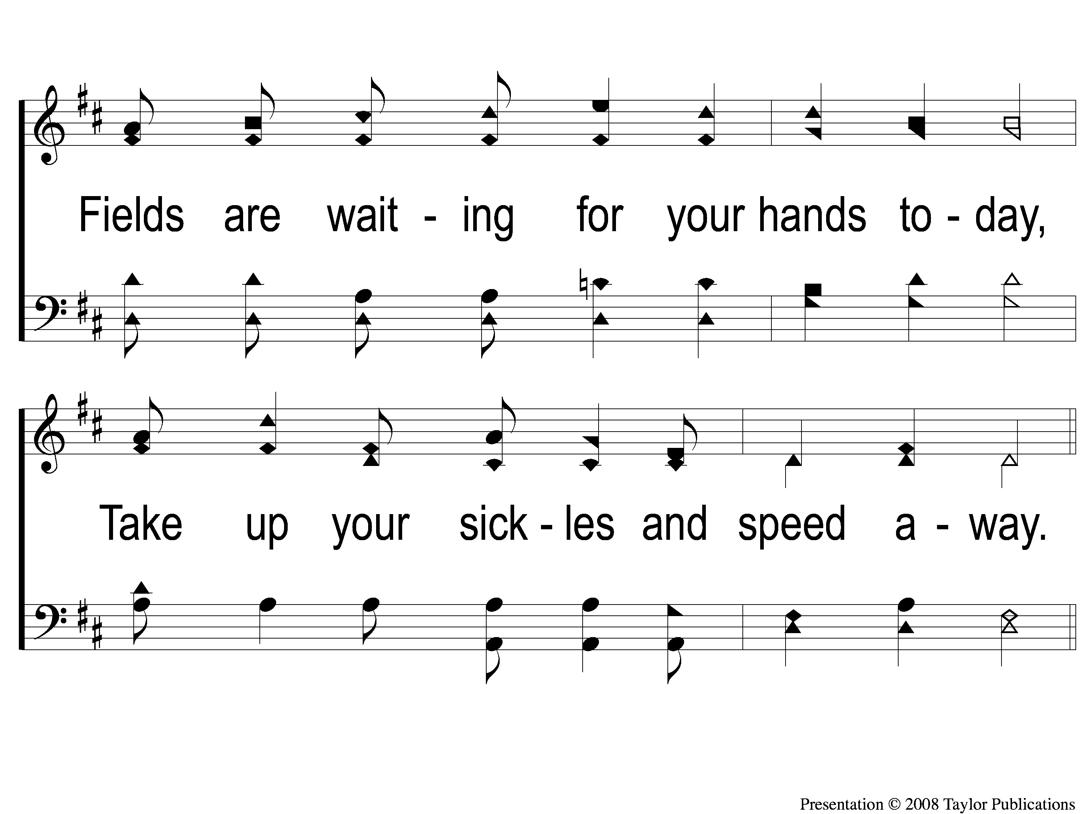
1-2 Go Into the Field
Go Into the Field
128

Slide 3
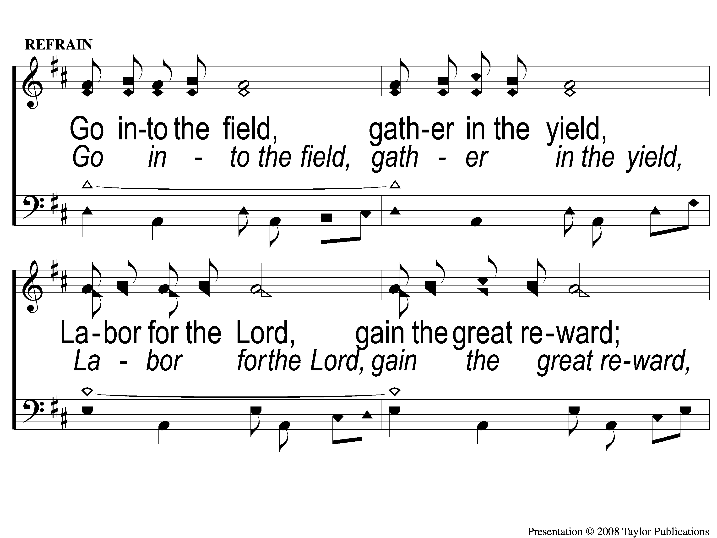
C-1 Go Into the Field
Go Into the Field
128

Slide 4
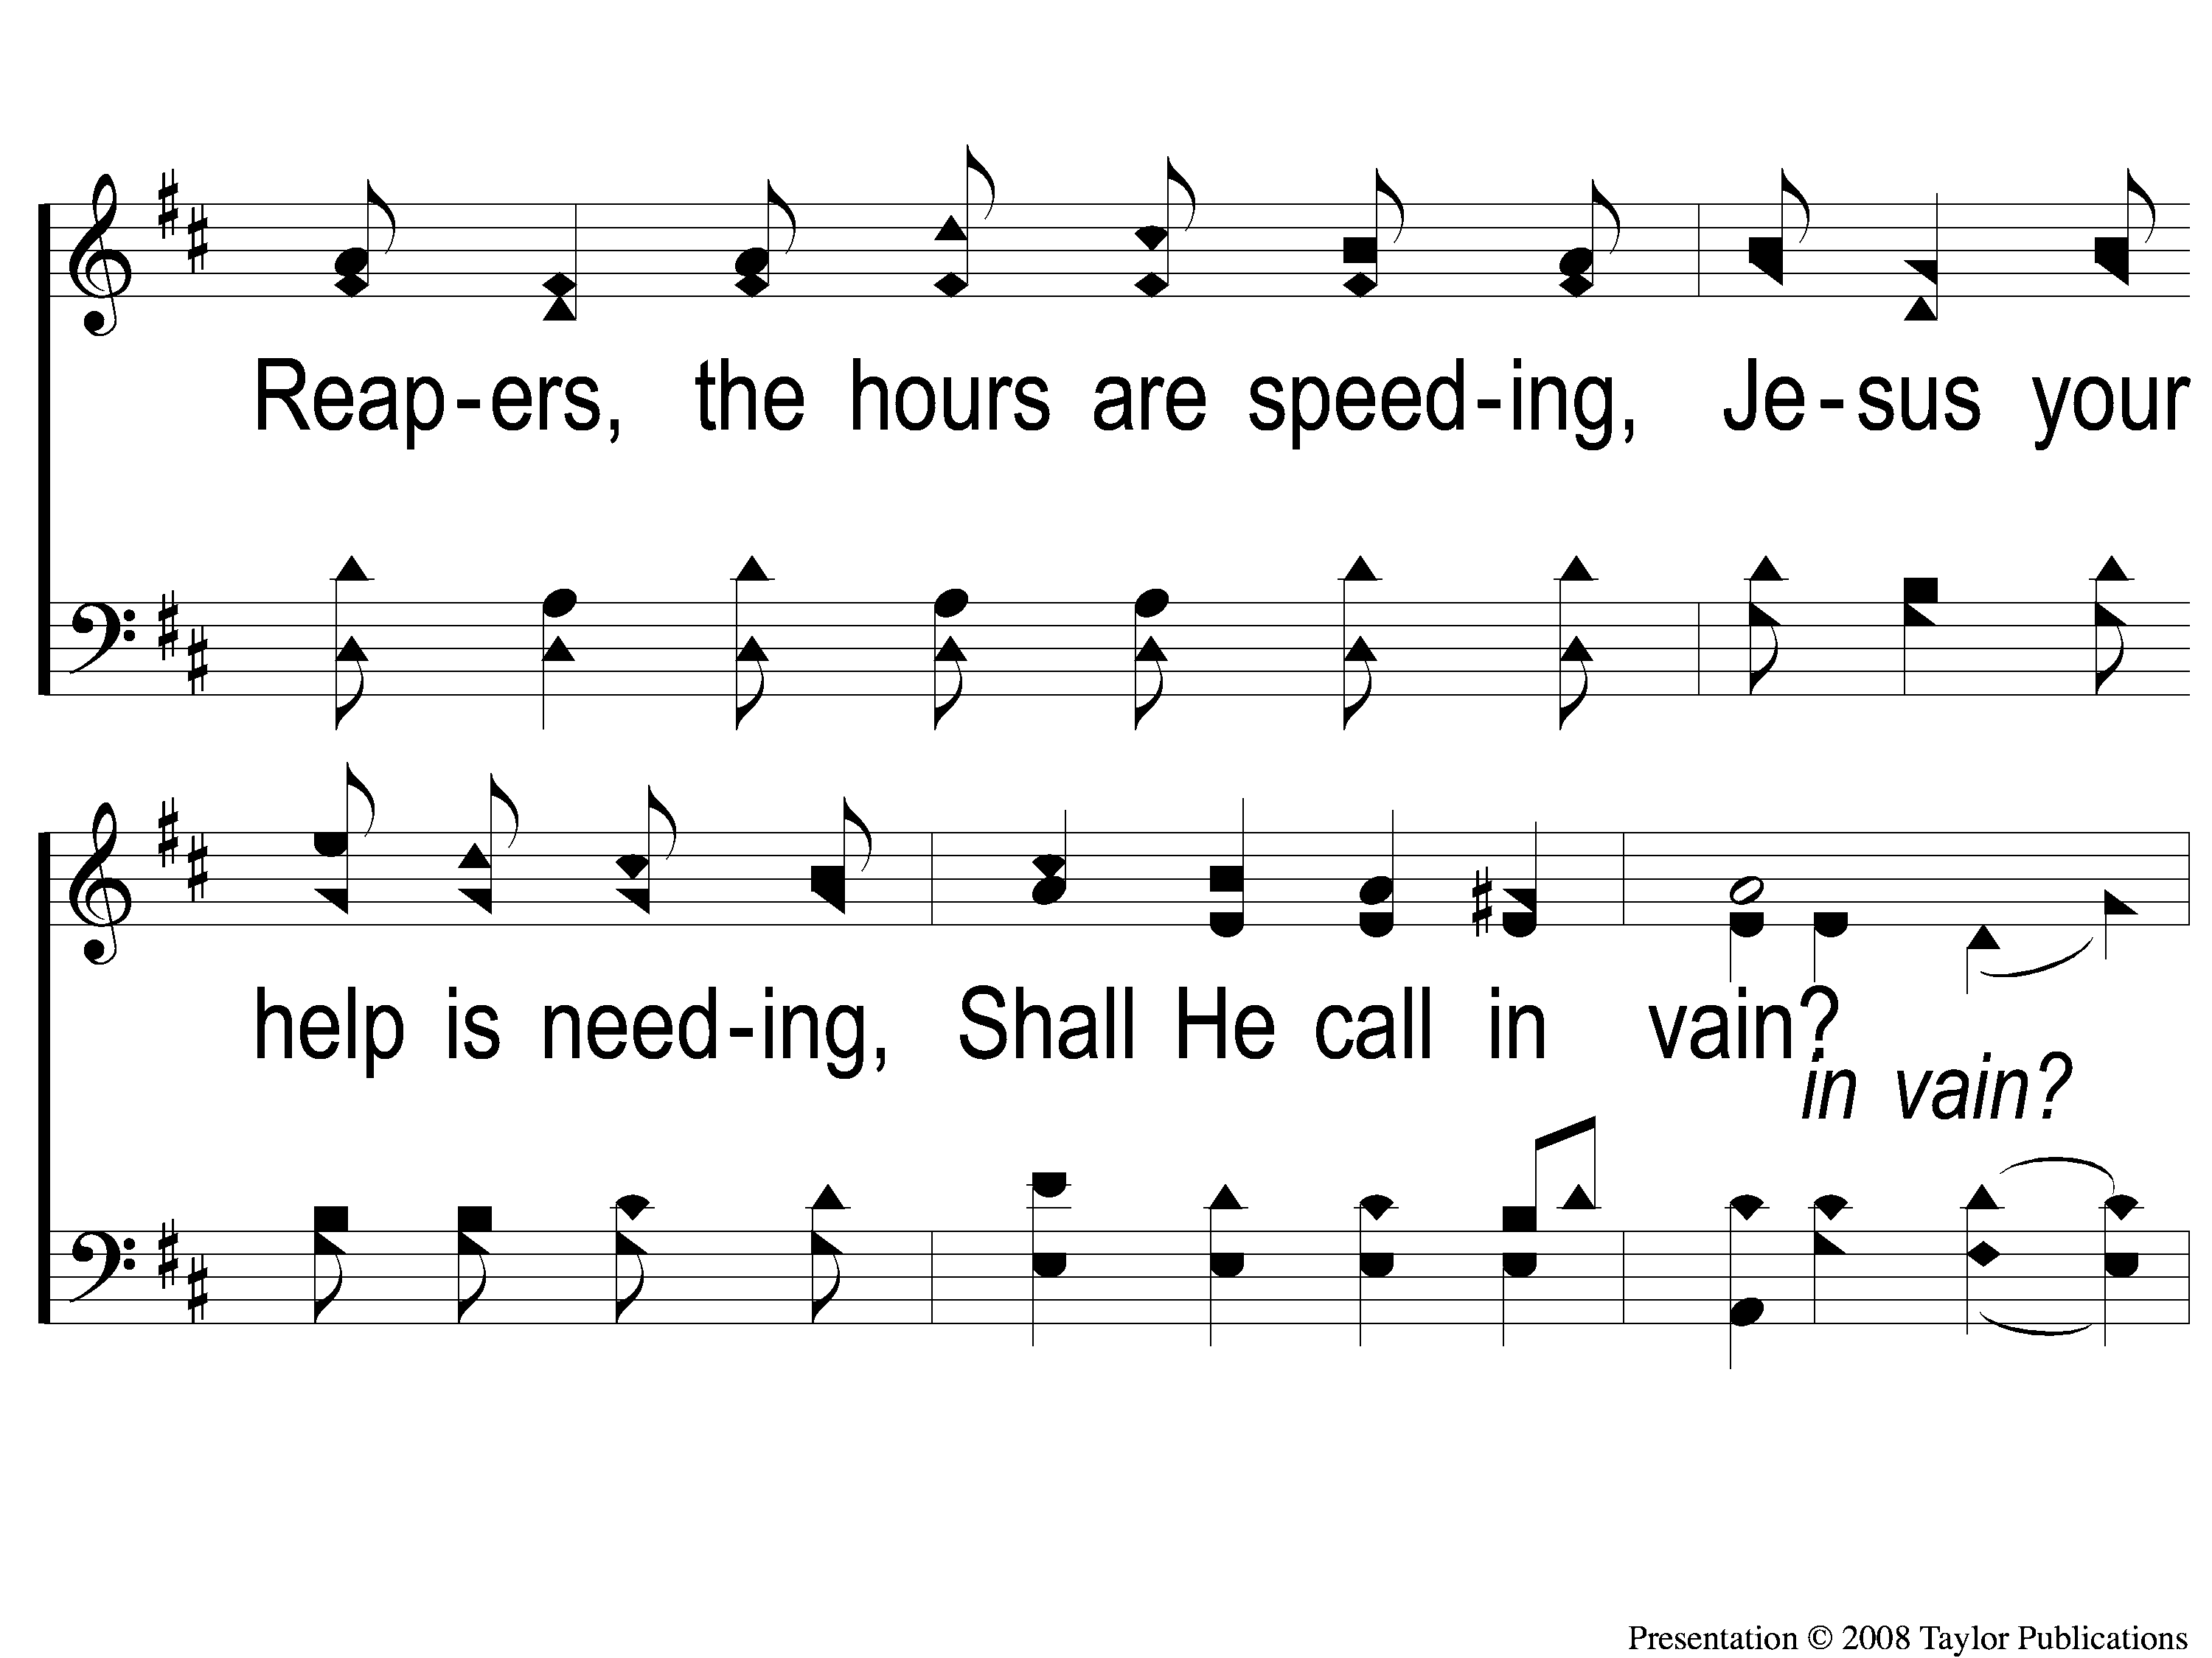
C-2 Go Into the Field
Go Into the Field
128

Slide 5
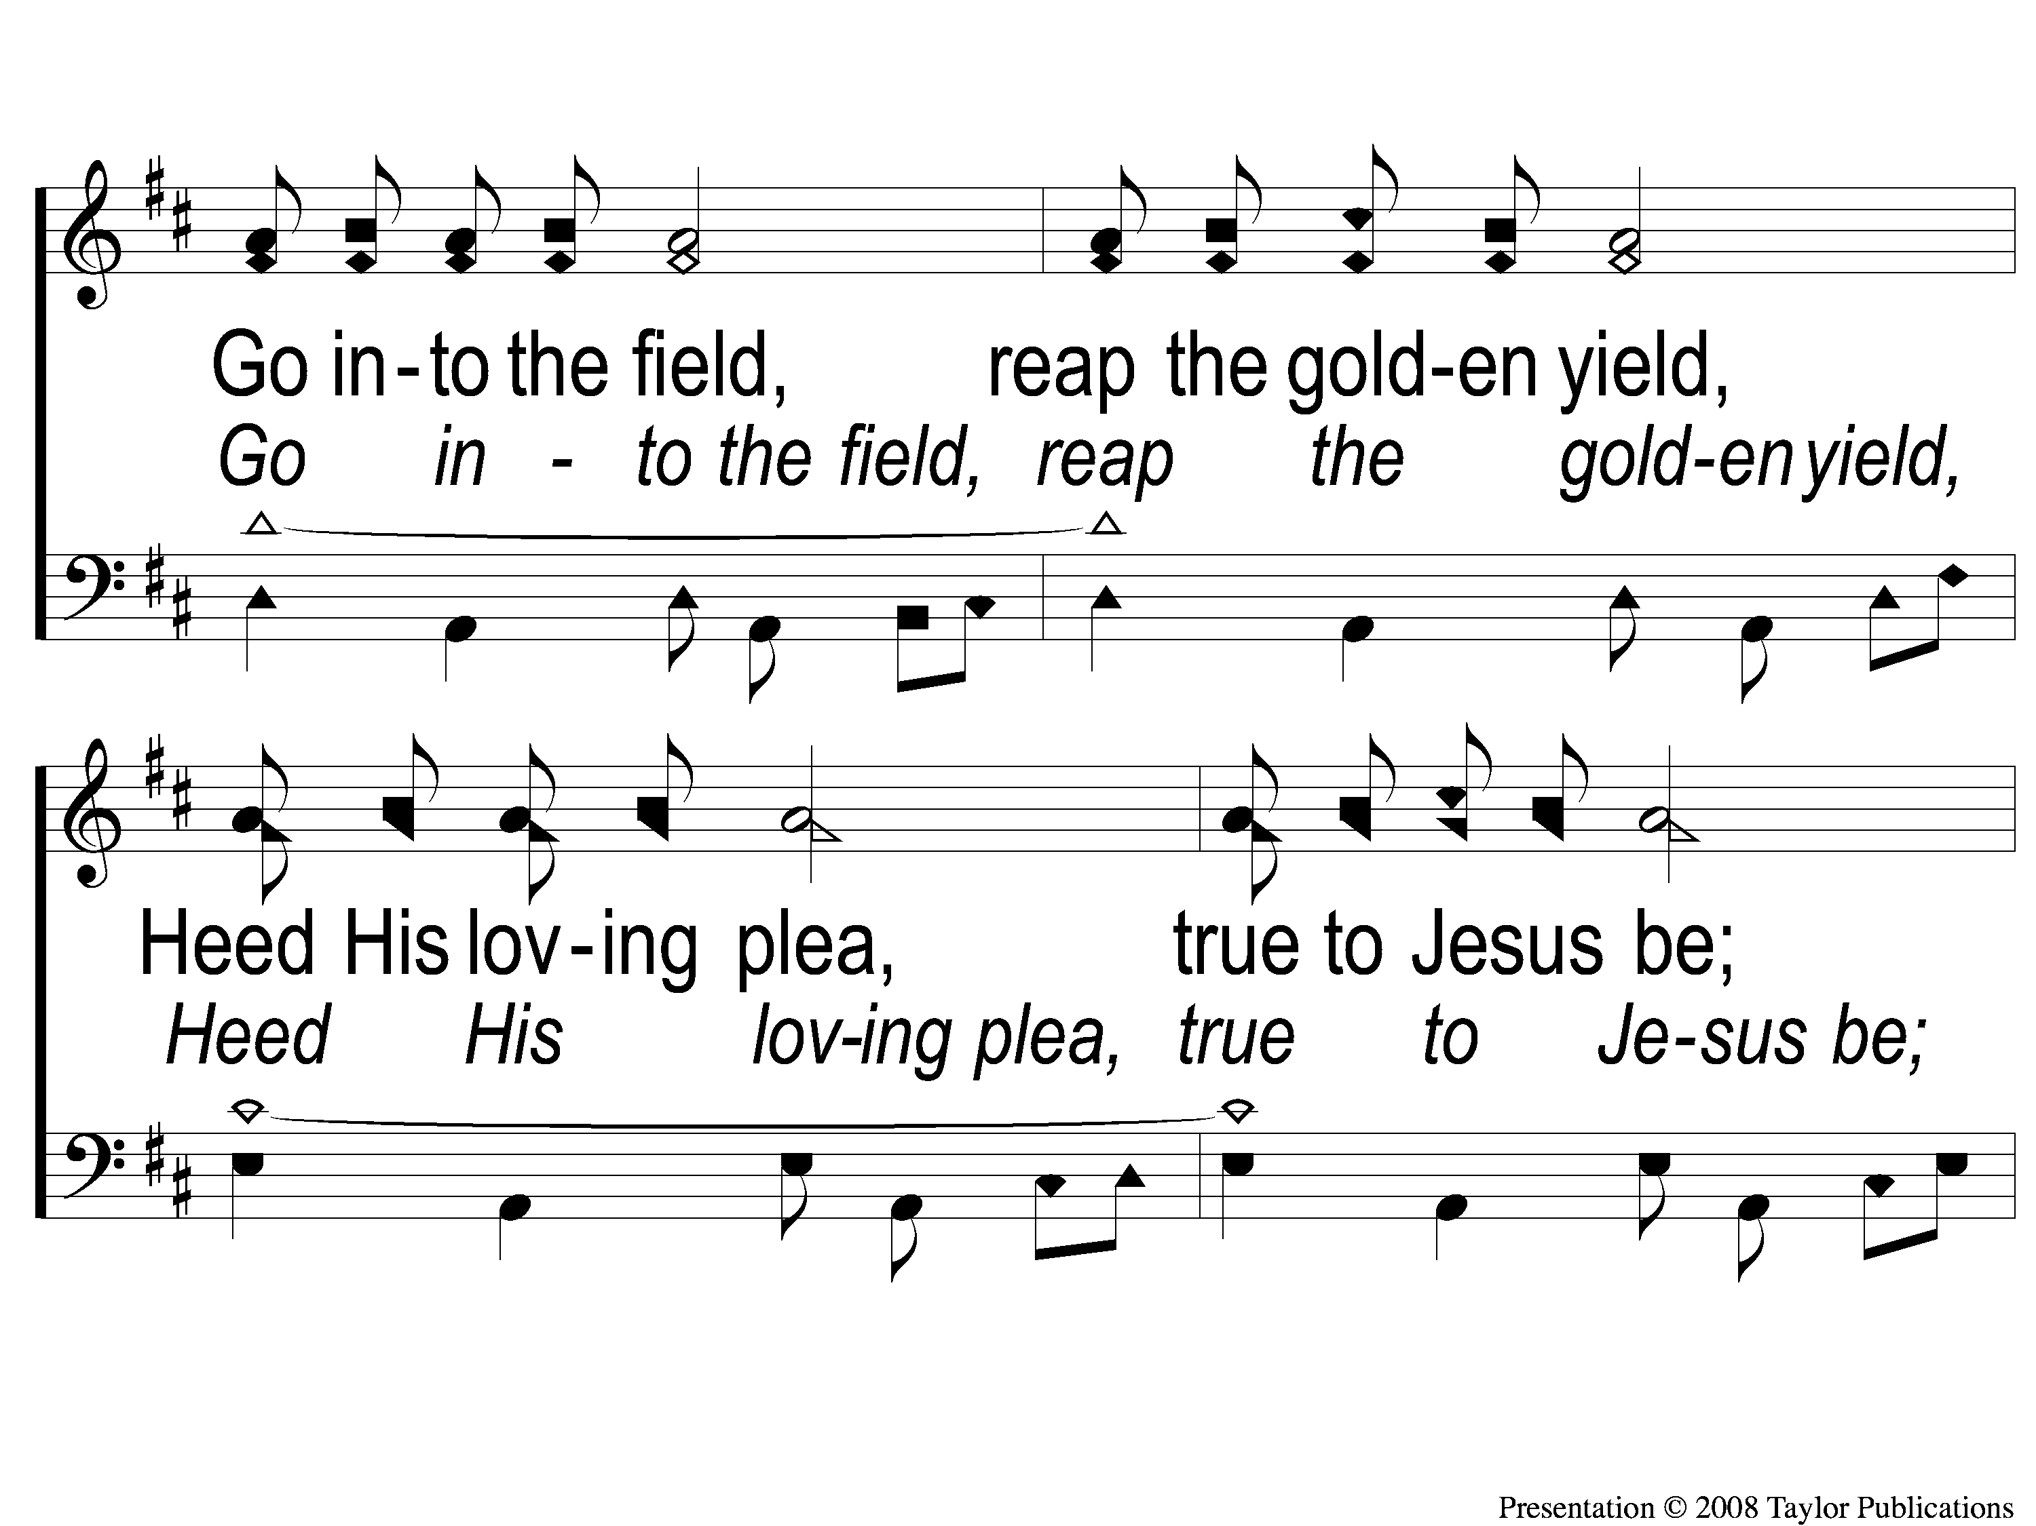
C-3 Go Into the Field
Go Into the Field
128

Slide 6
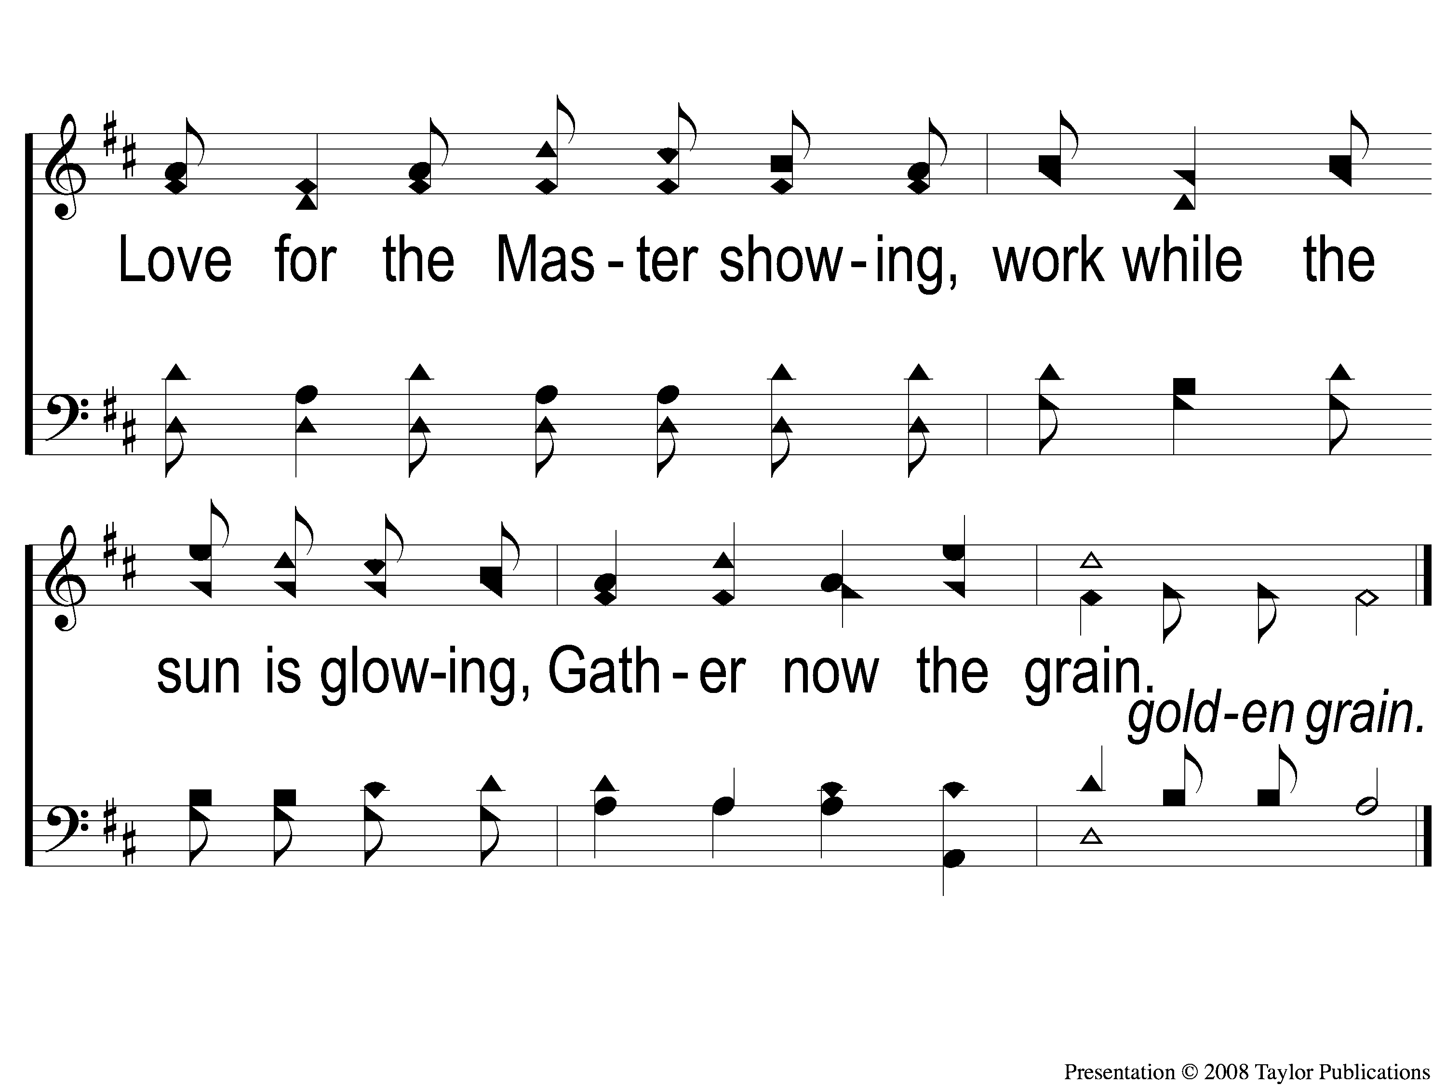
C-4 Go Into the Field
Go Into the Field
128

Slide 7
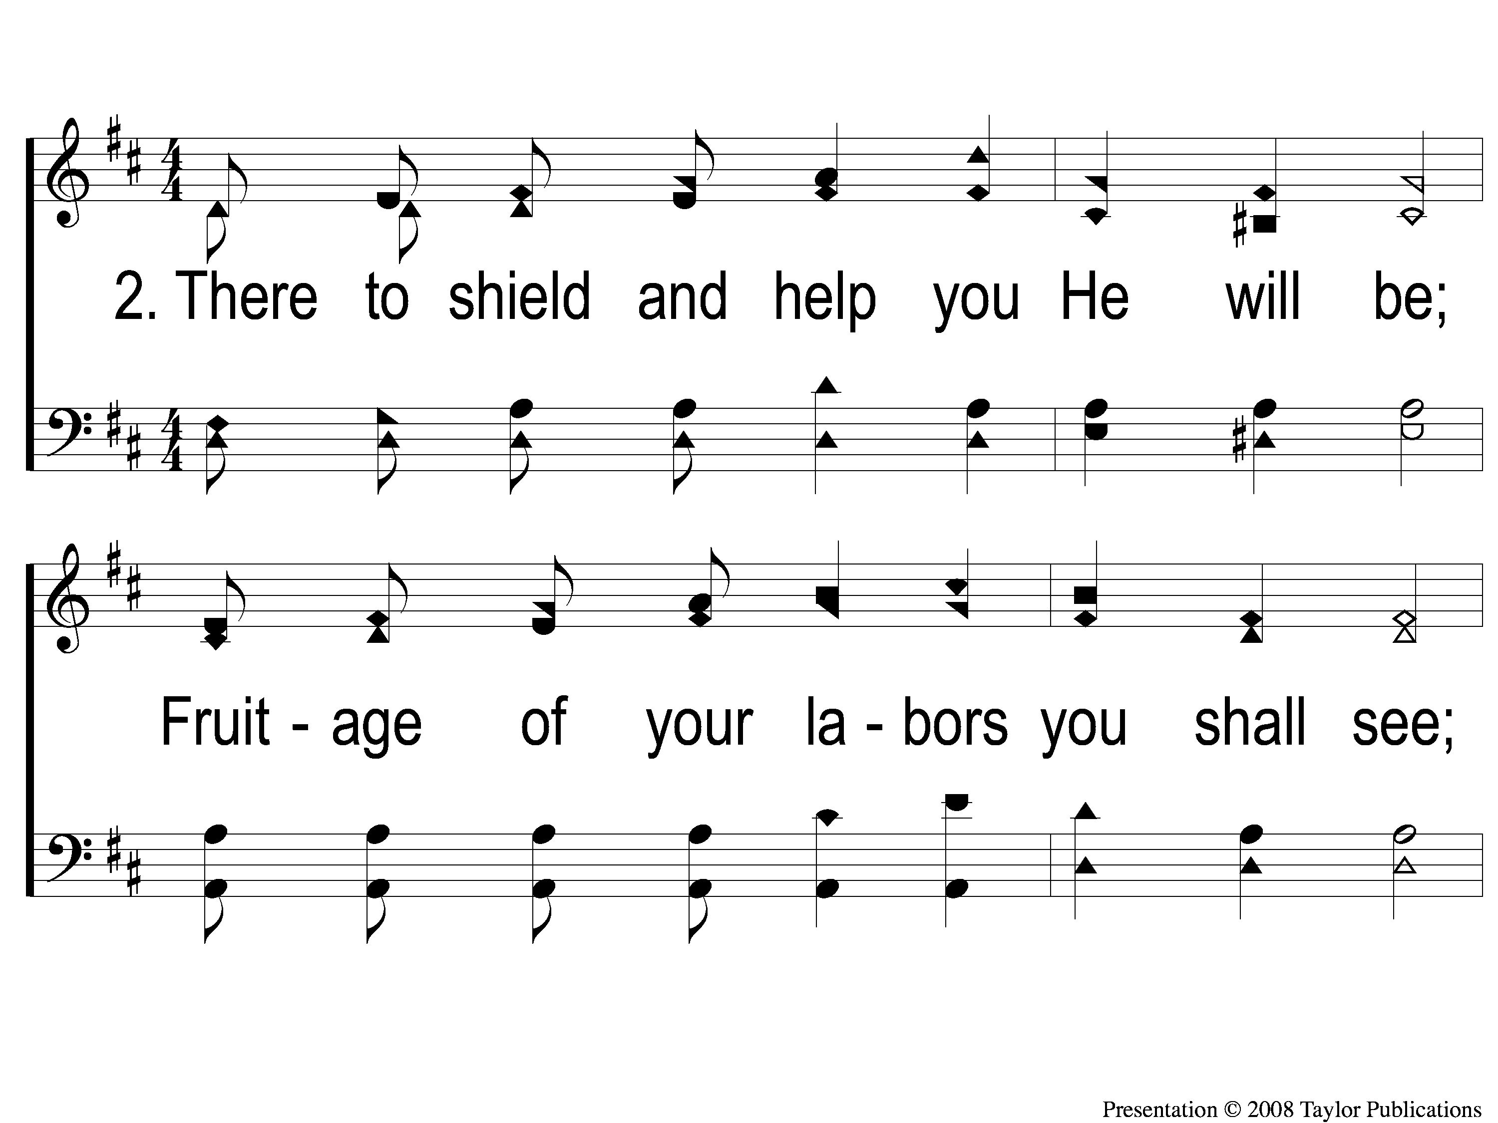
2-1 Go Into the Field
Go Into the Field
128

Slide 8
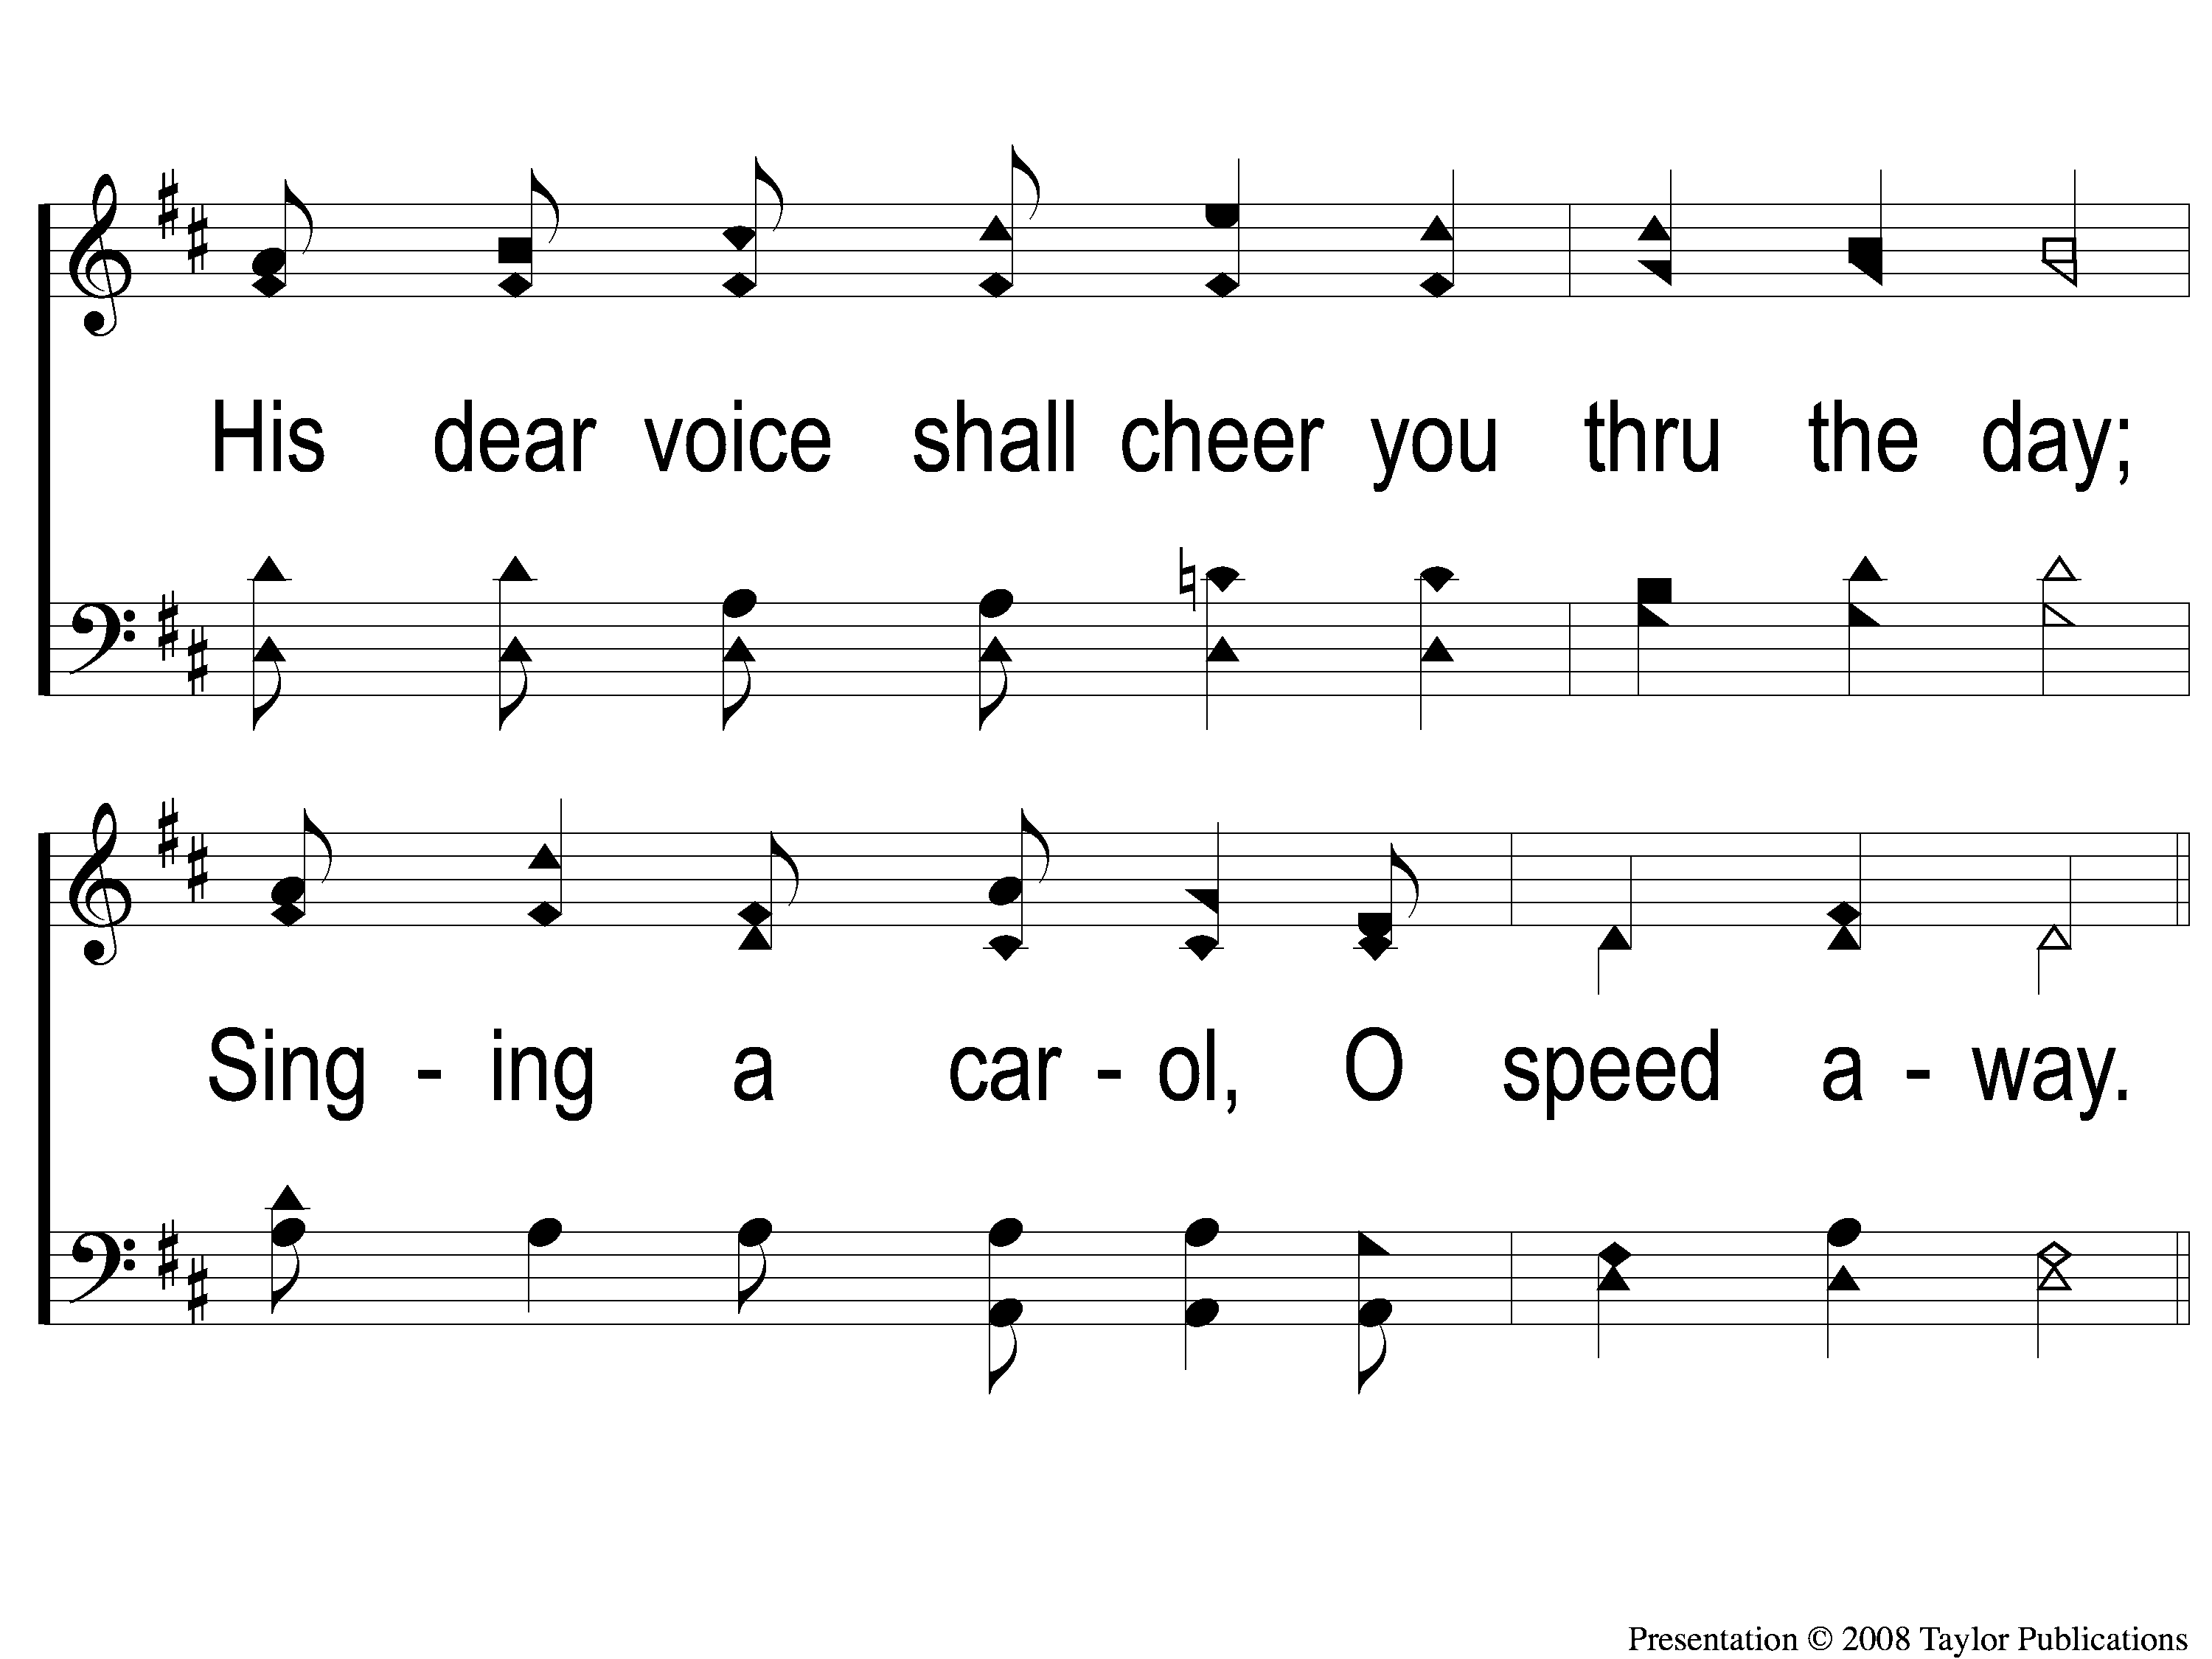
2-2 Go Into the Field
Go Into the Field
128

Slide 9
C-1 Go Into the Field
Go Into the Field
128

Slide 10
C-2 Go Into the Field
Go Into the Field
128

Slide 11
C-3 Go Into the Field
Go Into the Field
128

Slide 12
C-4 Go Into the Field
Go Into the Field
128

Slide 13
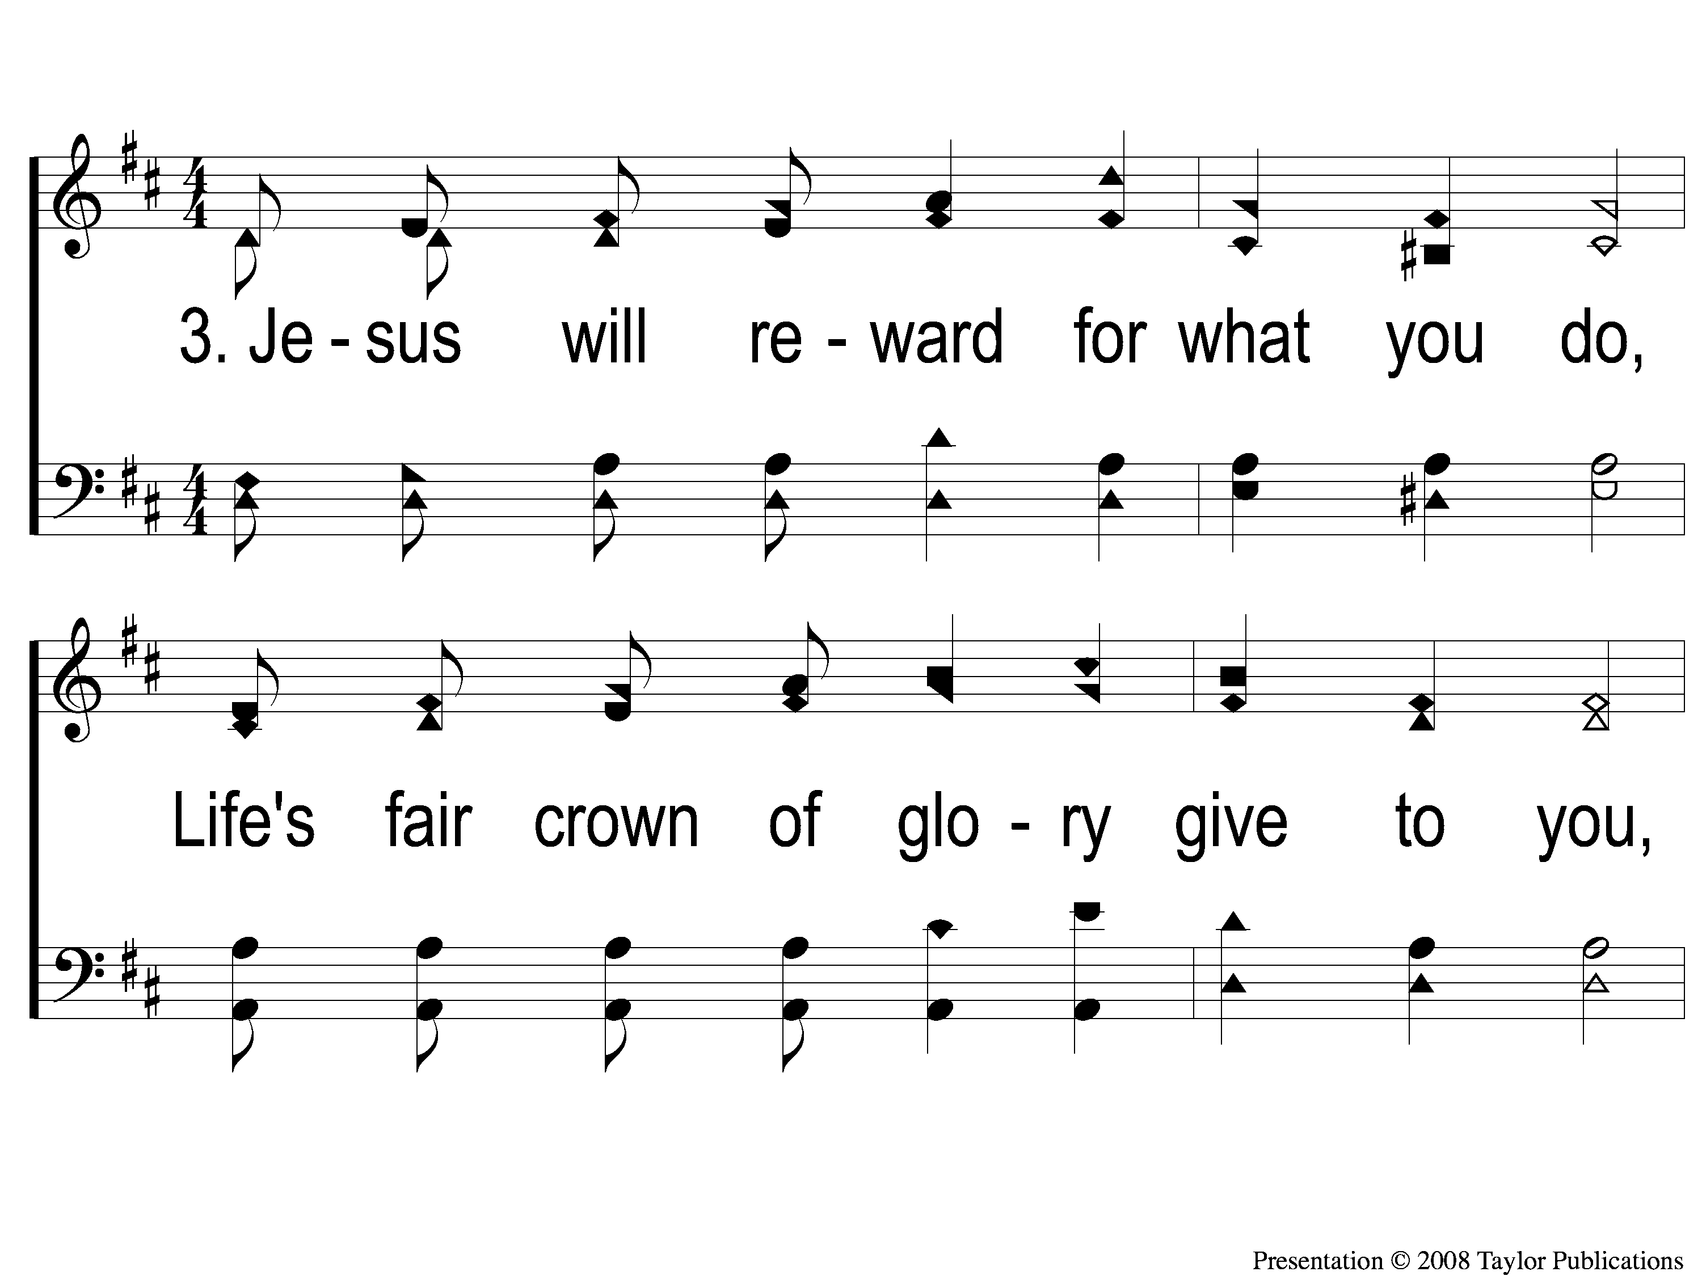
3-1 Go Into the Field
Go Into the Field
128

Slide 14
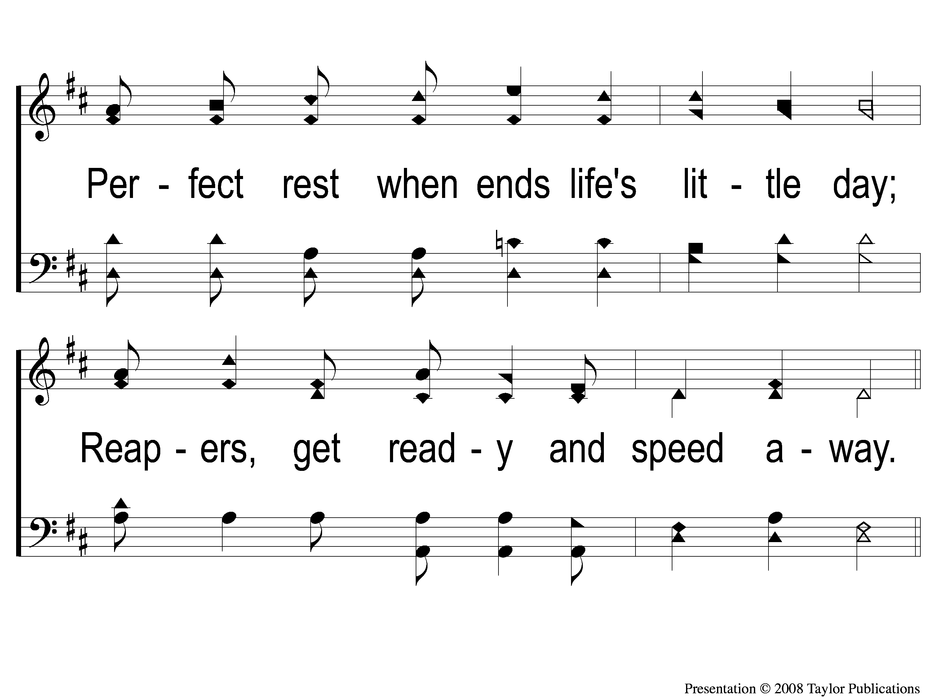
3-2 Go Into the Field
Go Into the Field
128

Slide 15
C-1 Go Into the Field
Go Into the Field
128

Slide 16
C-2 Go Into the Field
Go Into the Field
128

Slide 17
C-3 Go Into the Field
Go Into the Field
128

Slide 18
C-4 Go Into the Field
Go Into the Field
128

